Slide 1
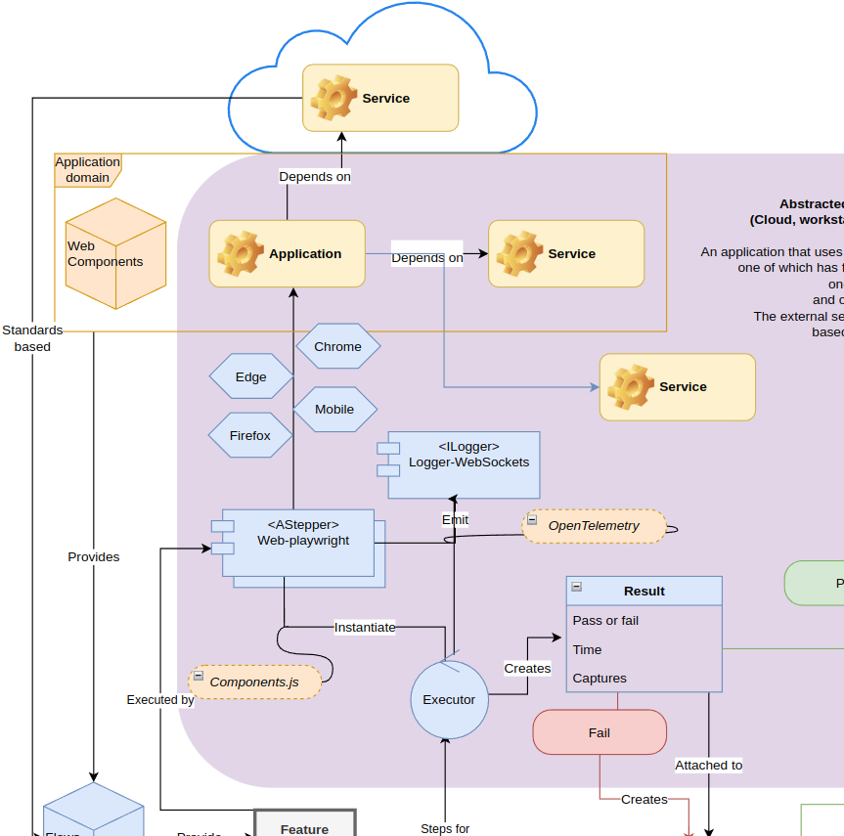
Reviews - refactor - reports
Oct 11, 2023
Overview diagram

Slide 2
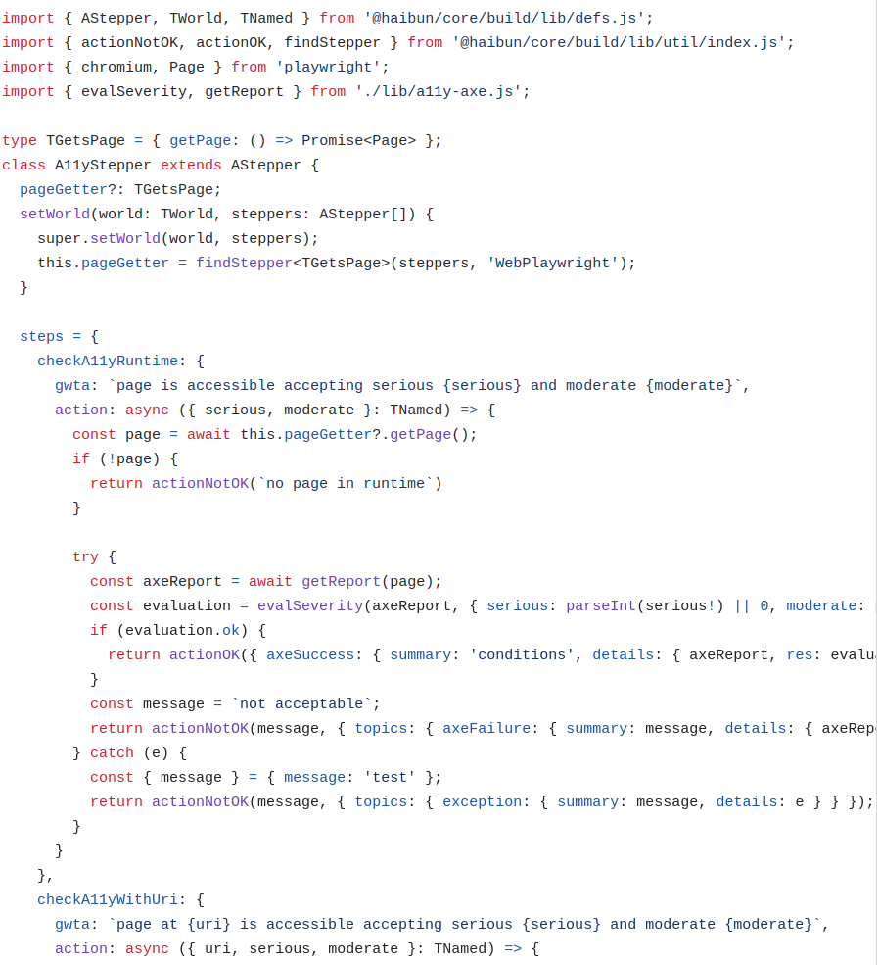
The refactoring
Reviews workflow was rushed out in a previous version.
* Fix Drastically simplify reviews design * Build cleanup
Principles - DX
✓ Simplicity of modules (minimum boilerplate, minimum version changes, streamlined new features)
✓ Clarity of results
𐄂 Best practices
𐄂 Easy to build on
𐄂 Minimum unique code
✓ Environment abstraction
✓ Versioning - IaC, auto issues

Slide 3
Reviews - previous
First find all the reviews and publish them to html
create found reviews
create found index
publish found reviews
Create dashboard
publish reviews dashboard link
create dashboard page
About 6000 convoluted LoC, xml template based

Slide 4
Refactor
First find all the reviews and publish them to json
create found history
Create dashboard and reviewer
create reviews pages
About 2000 straightforward LoC, Web Component based
Turn log messages into typed data for better re-use

Slide 5
Object.defineProperty(exports, "__esModule", { value: true });
exports.resolvePublishedReview = exports.parseLinks = exports.getLatestPublished = void 0;
var apiUrl = '/reviews';
function getLatestPublished() {
return __awaiter(this, void 0, void 0, function () {
var response, data, latest;
return __generator(this, function (_a) {
switch (_a.label) {
case 0: return [4 /*yield*/, fetch("".concat(apiUrl, "/"))];
case 1:
response = _a.sent();
return [4 /*yield*/, response.text()];
case 2:
data = _a.sent();
latest = parseLinks(data).map(function (link) { return link.replace(apiUrl, ''); })
.map(function (link) { return link.replace(/^\//, ''); }).filter(function (link) { return link.length > 0; });
return [2 /*return*/, latest];
}
});
});
}
exports.getLatestPublished = getLatestPublished;
function parseLinks(html) {
var links = [];
var linkRegex = /<a\s+(?:[^>]*?\s+)?href=(["'])(.*?)\1/g;
var match;
while ((match = linkRegex.exec(html)) !== null) {
var link = match[2];
links.push(link);
}
return links;
}
exports.parseLinks = parseLinks;
function resolvePublishedReview(link) {
return __awaiter(this, void 0, void 0, function () {
var response, reviewLink;
return __generator(this, function (_a) {
switch (_a.label) {
case 0: return [4 /*yield*/, fetch("".concat(apiUrl, "/").concat(link))];
case 1:
response = _a.sent();
return [4 /*yield*/, response.json()];
case 2:
reviewLink = _a.sent();
reviewLink.link = reviewLink.link.replace(/.*\//, '');
return [2 /*return*/, reviewLink];
}
});
});
}
exports.resolvePublishedReview = resolvePublishedReview;
❌ Build cleanup
"use strict";
var __awaiter = (this && this.__awaiter) || function (thisArg, _arguments, P, generator) {
function adopt(value) { return value instanceof P ? value : new P(function (resolve) { resolve(value); }); }
return new (P || (P = Promise))(function (resolve, reject) {
function fulfilled(value) { try { step(generator.next(value)); } catch (e) { reject(e); } }
function rejected(value) { try { step(generator["throw"](value)); } catch (e) { reject(e); } }
function step(result) { result.done ? resolve(result.value) : adopt(result.value).then(fulfilled, rejected); }
step((generator = generator.apply(thisArg, _arguments || [])).next());
});
};
var __generator = (this && this.__generator) || function (thisArg, body) {
var _ = { label: 0, sent: function() { if (t[0] & 1) throw t[1]; return t[1]; }, trys: [], ops: [] }, f, y, t, g;
return g = { next: verb(0), "throw": verb(1), "return": verb(2) }, typeof Symbol === "function" && (g[Symbol.iterator] = function() { return this; }), g;
function verb(n) { return function (v) { return step([n, v]); }; }
function step(op) {
if (f) throw new TypeError("Generator is already executing.");
while (g && (g = 0, op[0] && (_ = 0)), _) try {
if (f = 1, y && (t = op[0] & 2 ? y["return"] : op[0] ? y["throw"] || ((t = y["return"]) && t.call(y), 0) : y.next) && !(t = t.call(y, op[1])).done) return t;
if (y = 0, t) op = [op[0] & 2, t.value];
switch (op[0]) {
case 0: case 1: t = op; break;
case 4: _.label++; return { value: op[1], done: false };
case 5: _.label++; y = op[1]; op = [0]; continue;
case 7: op = _.ops.pop(); _.trys.pop(); continue;
default:
if (!(t = _.trys, t = t.length > 0 && t[t.length - 1]) && (op[0] === 6 || op[0] === 2)) { _ = 0; continue; }
if (op[0] === 3 && (!t || (op[1] > t[0] && op[1] < t[3]))) { _.label = op[1]; break; }
if (op[0] === 6 && _.label < t[1]) { _.label = t[1]; t = op; break; }
if (t && _.label < t[2]) { _.label = t[2]; _.ops.push(op); break; }
if (t[2]) _.ops.pop();
_.trys.pop(); continue;
}
op = body.call(thisArg, _);
} catch (e) { op = [6, e]; y = 0; } finally { f = t = 0; }
if (op[0] & 5) throw op[1]; return { value: op[0] ? op[1] : void 0, done: true };
}
};
const apiUrl = '/reviews';
export async function getLatestPublished() {
const response = await fetch(`${apiUrl}/`);
const data = await response.text();
const latest = parseLinks(data).map(link => link.replace(apiUrl, ''))
.map(link => link.replace(/^\//, '')).filter(link => link.length > 0);
return latest;
}
export function parseLinks(html) {
const links = [];
const linkRegex = /<a\s+(?:[^>]*?\s+)?href=(["'])(.*?)\1/g;
let match;
while ((match = linkRegex.exec(html)) !== null) {
const link = match[2];
links.push(link);
}
return links;
}
export async function resolvePublishedReview(link) {
const response = await fetch(`${apiUrl}/${link}`);
const reviewLink = await response.json();
reviewLink.link = reviewLink.link.replace(/.*\//, '');
return reviewLink;
}
2023 web - lightweight, clear
2000 - 2023 web. One file.

Slide 6

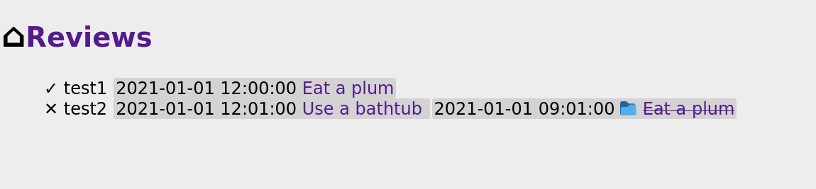
Review reports
Add a report by adding TArtifact to a message

Slide 7
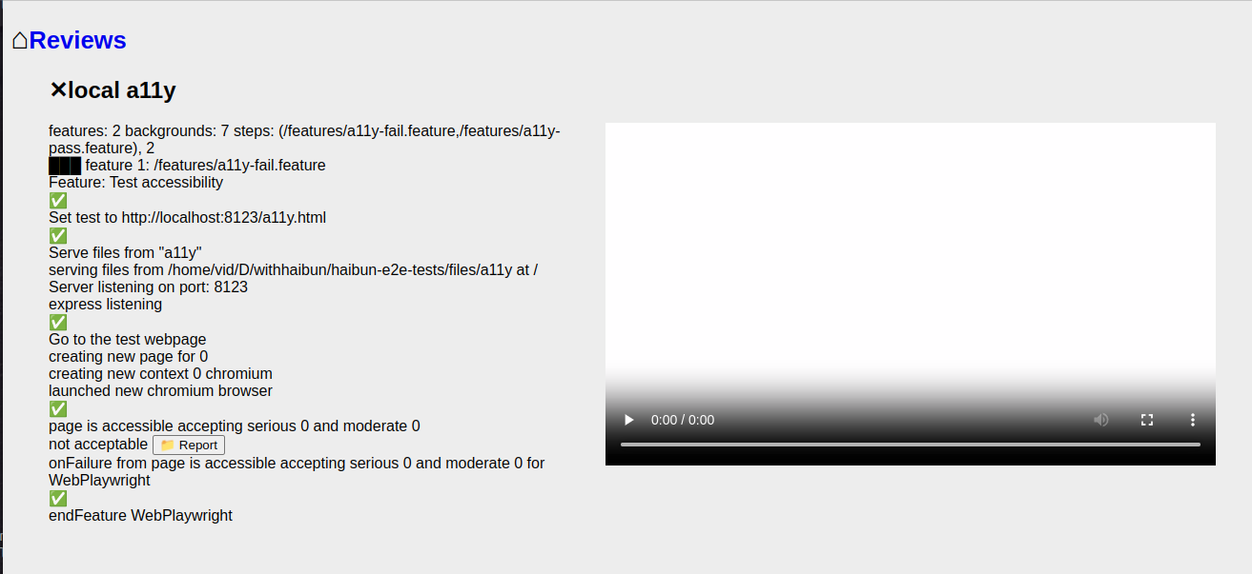
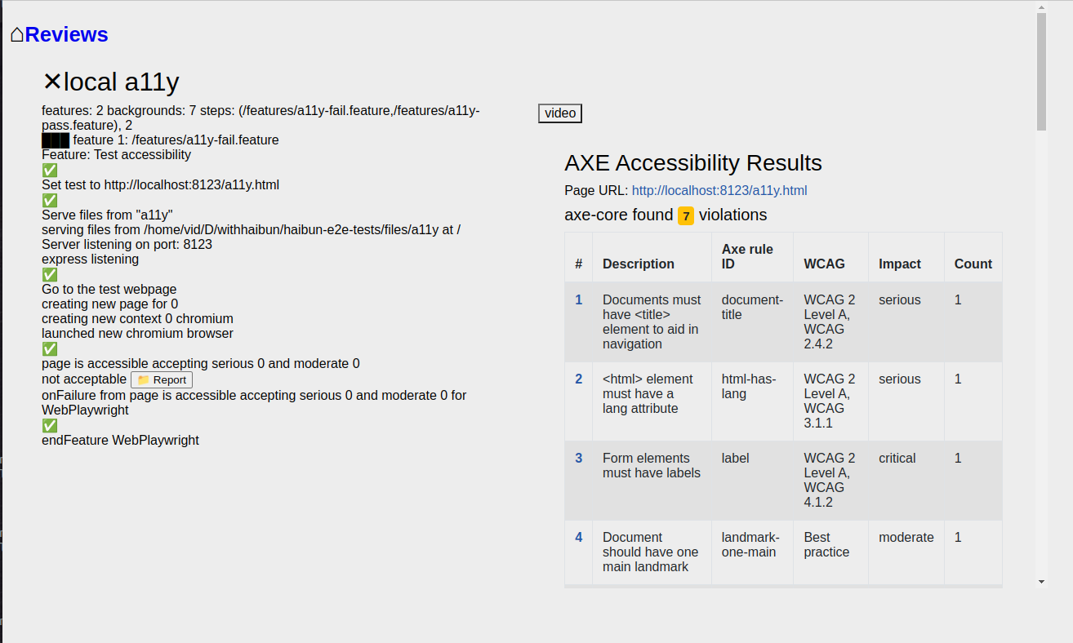
Review reports

Slide 8
Report types
Accessibility (HTML)
Failure (screen capture) Review (video)
Review (HAR)
Other reports

Slide 9
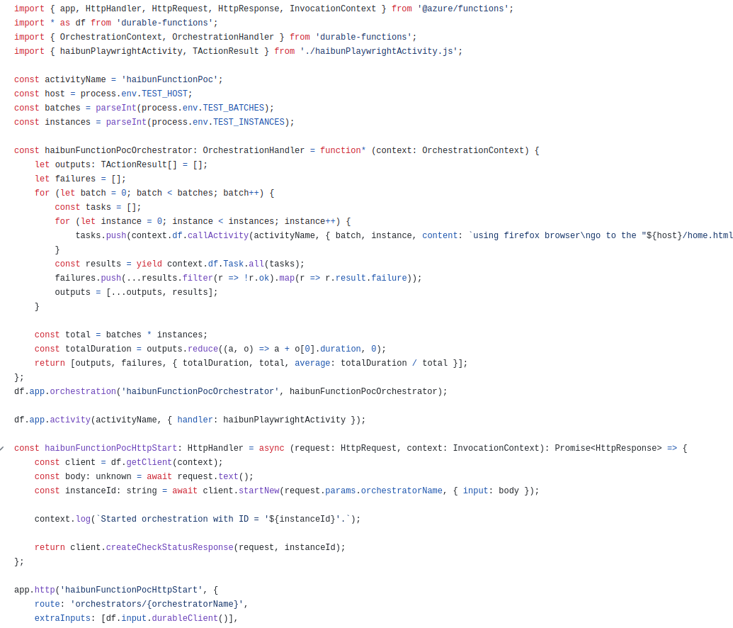
Next steps (finally)
Gccollab legacy tests
Next gccollab tests
Load tests
GCExchange tests
Auto issues
- repo version + test name + step

